Slide 1
NUTRITION AGENT
CAPSTONE PROJECT
Presented By:
1. Nandana Renjith-Amrita Vishwa Vidyapeetham-CSE

Slide 2
OUTLINE
Problem Statement
Proposed System/Solution
System Development Approach (Technology Used)
Algorithm & Deployment
Result (Output Image)
Conclusion
Future Scope
References

Slide 3
Problem Statement
Maintaining a healthy diet is increasingly difficult in today’s fast-paced lifestyle, where many individuals lack the time, awareness, or personalized support to make informed nutritional choices. This project addresses the growing need for accessible dietary guidance by exploring how emerging technologies can improve the way people receive nutrition advice. It investigates the potential of artificial intelligence, cloud computing, and multimodal interfaces—such as text, voice, and image input—to enhance user engagement and promote healthier eating habits. The initiative aims to bridge the gap between traditional diet planning and personalized support, focusing on convenience, real-time interaction, and user-centric nutritional assistance.

Slide 4
Proposed Solution
The proposed system addresses the growing need for personalized dietary guidance through an AI-powered nutrition assistant. The solution is composed of the following key components:
AI and Cognitive Services : he proposed system delivers real-time, personalized nutrition guidance through an AI-powered assistant built using IBM Watson AI and deployed on IBM Cloud. The assistant uses IBM Watson Assistant to handle natural, conversational interactions with users. Voice-based communication is enabled through Watson Speech-to-Text and Text-to-Speech services, while IBM Watson Visual Recognition or Maximo Vision supports image-based food analysis. The assistant provides tailored meal recommendations, food swap suggestions, and nutrition breakdowns based on user input and preferences such as dietary goals (e.g., diabetic, vegetarian). The solution is deployed as a secure, scalable, and accessible cloud-based application with a multimodal user interface.
Deployment: Deploy the assistant on IBM Cloud for scalability and security. Ensure cross-platform accessibility (mobile, desktop) with a simple, interactive UI supporting voice, text, and image-based queries
Evaluation: Measure system performance based on user feedback, relevance of suggestions, and response accuracy. Continuously refine the models based on new inputs and usage patterns.
Result: The system will provide users with a smart, context-aware, real-time nutrition assistant that bridges the gap between general diet apps and expert dietitian guidance.

Slide 5
System Approach
The system follows a service-oriented and modular architecture, leveraging IBM Watson’s AI services to handle specific functionalities in a scalable and decoupled manner. It adopts a multimodal interaction model, allowing users to communicate via text, voice, and images. Key components interact through API calls and cloud-based services, ensuring smooth integration and real-time response.
Watson Assistant handles the conversational logic and context-aware dialogue management.
Plateform : Agent beta lab
Framework : LanGraph
Architecture : React
Model : Granite-3-3-7b-instruct large language model
Deployment : IBM cloud
Assosiatives : Watson runtime

Slide 6
Algorithm & Deployment
In the algorithum session ,Create an IBM account
IBM account -> watson ai (this would help in building ai agents without coding)
watson ai -> gen ai solutions -> Automating task ai agents -> Agent lab(beta)
Agent lab (beta) : plateform used to build and deploy ai can be used to make your application more flexible and dynamic
go to watson ai homepage
CREATING THE PROJECT
watson ai homepage -> create a sandbox project -> create a project instead
create a project -> Add a name -> chose the cloud object storage ->Select Lite(deprecated) (which is a freeplan) -> create
Cloud object storage : is a scalable, internet-based storage system that allows you to store and manage large amounts of unstructured data—such as images, videos, documents, and backups—as objects rather than traditional files or blocks.
Refresh -> Create project -> go to home Build an AI agent to automate tasks -> click Associate service
select the region ->Dallias (service name watson ai)-> create -> Home page -> Build an AI agent to automate tasks

Slide 7
ALGORITHUM AND DEPLOYMENT
CREATING THE AGENT
give the name to the agent(Nutrition agent) ->Architecture used is React Framework is LanGraph -> Add instructions which is suitable for nutrition agent -> for common instructions add to not give answers to any academic or coding questions -> tools(google search,duck duck go search etc) -> select the model Granite-3-3-7b-instruct -> then you can give some prompts to test it whether it is working or not(eg: give me a healthy recipe) -> Save the agent
DEPLOYMENT
we deploy the model using IBM cloud -> fter saving click deploy->Add deployment spaces-> click on watson runtime ->create-> go to saved agent -> click deploy -> enter the name (nutrition agent) -> select production -> watson runtime then create -> go to home check for projects -> click nutrition agent -> thus it is deployed

Slide 8
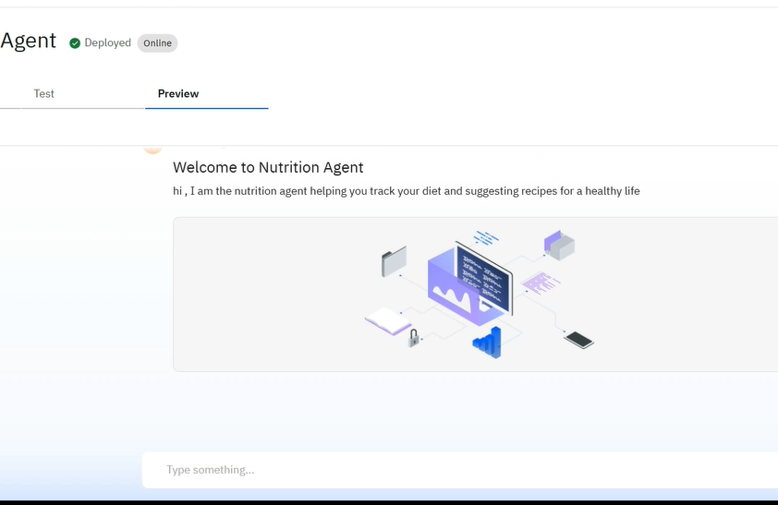
Result
video link :https://amritauniv-my.sharepoint.com/:v:/g/personal/am_sc_u4cse23056_am_students_amrita_edu/EcVbUMkmrg5DvG2hwUUQAUUBN5cIB59dbsJHgDzL7EKQ1g?nav=eyJyZWZlcnJhbEluZm8iOnsicmVmZXJyYWxBcHAiOiJPbmVEcml2ZUZvckJ1c2luZXNzIiwicmVmZXJyYWxBcHBQbGF0Zm9ybSI6IldlYiIsInJlZmVycmFsTW9kZSI6InZpZXciLCJyZWZlcnJhbFZpZXciOiJNeUZpbGVzTGlua0NvcHkifX0&e=uBLyh2
github link:https://github.com/Nandanarenjith/Nutrition-agent

Slide 9
Conclusion
The AI-powered nutrition assistant leverages IBM Watson’s advanced cognitive services to provide personalized, real-time dietary guidance through text, voice, and image-based interactions. By integrating natural language processing, speech recognition, and visual analysis into a unified platform, the system bridges the gap between generic diet apps and professional nutritional advice. Its multimodal interface makes healthy eating more accessible, engaging, and user-centric. Deployed on IBM Cloud, the solution is scalable, secure, and adaptable to a wide range of dietary needs and lifestyles. Overall, this intelligent assistant empowers users to make informed nutritional choices and promotes healthier living through the power of AI.

Slide 10
Future scope
The nutrition agent holds significant potential for enhancement and scalability. In the future, the system can incorporate additional data sources such as wearable fitness trackers, medical reports, or real-time biometric data to offer even more personalized and dynamic recommendations. The AI model can be further optimized using advanced machine learning techniques like reinforcement learning, graph neural networks, or few-shot learning for better contextual understanding and adaptability to diverse user needs.
Geographically, the system can be scaled to support multiple languages and regions, offering culturally and regionally appropriate dietary suggestions. Integration with edge computing devices—like smartwatches or health monitors—would enable offline and real-time functionality, particularly useful in remote or low-connectivity areas.
Additionally, a feedback loop mechanism could be implemented to continuously improve suggestions based on user behavior and satisfaction. Visual capabilities can also be enhanced with more sophisticated computer vision models to better recognize complex meals or packaged food items.
Finally, the system could be expanded to include predictive health insights, integrating with healthcare providers to act as a virtual dietitian assistant for preventive care and chronic disease management.

Slide 11
References
IBM CLOUD (Videos)
Edunet (IBM Skillbuild) - lectures
google
chatgpt

Slide 12
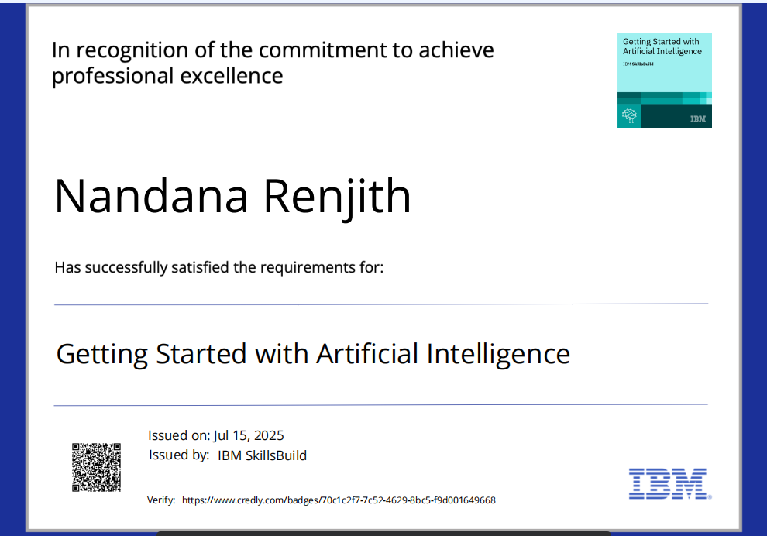
IBM Certifications
Screenshot/ credly certificate( getting started with AI)

Slide 13
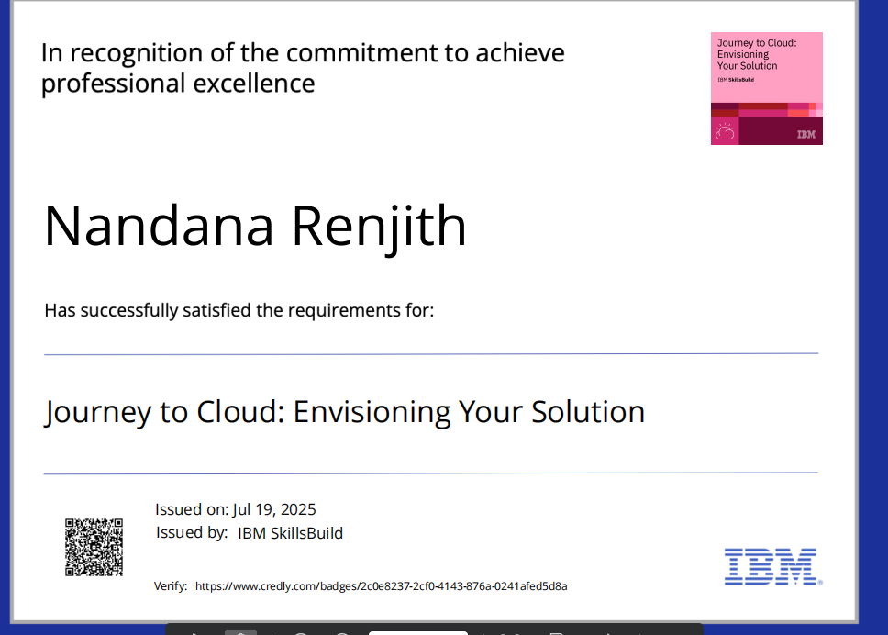
IBM Certifications
Screenshot/ credly certificate( Journey to Cloud)

Slide 14
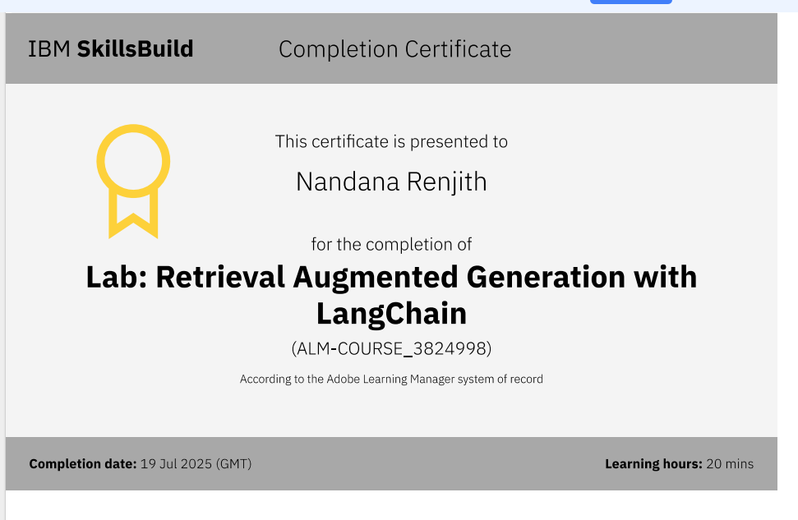
IBM Certifications
Screenshot/ credly certificate( RAG Lab)

Slide 15
THANK YOU

